Slide 1
Introduction to NLP
Heng Ji
jih@rpi.edu
September 3, 2014

Slide 2
Outline
Course Overview
Introduction to NLP
Introduction to Watson
Watson in NLP View
Machine Learning for NLP
Why NLP is Hard

Slide 3
Homepages
Course homepage
http://nlp.cs.rpi.edu/course/fall14/nlp.html
My homepage
http://nlp.cs.rpi.edu/hengji.html
TA (Qi Li)’s homepage
http://homepages.rpi.edu/~liq7/
My lab’s homepage
http://nlp.cs.rpi.edu
Notes:
How many of you know me?

Slide 4
Course Basics
Office hour (Room 2148, Winslow Building)
11:30pm-12:30pm Wednesday
TA Office hour (Room 1108, Winslow Building)
11:30am-12:30pm Wednesday
Raise up any questions and participate discussions at the mailing list
Feel free to drop me email for any questions and feedback: jih@rpi.edu
Notes:
Blackboard?

Slide 5
Goal and Topics of This Course
Introduce you to Natural Language Processing (NLP) problems & solutions; and some effective machine learning tools, using Deep Question Answering (Watson) as a case study
We’re going to study what goes into getting computers to perform useful and interesting tasks involving human languages.
We are also concerned with the insights that such computational work gives us into human processing of language.
It’s not a pure Watson engineering course; it’s a basic NLP science course.
At the end you should:
Learn basic NLP techniques and approaches
Feel some ownership over the formal & statistical models
Learn technical paper writing and presentation skills
Learn some promising NLP applications
One student team’s term project will be selected to participate in the IBM Watson Academic Initiative Competition
7 Teams from Top AI Universities
$100K Prize!

Slide 6
Course Organization
Heng will teach most lectures
Will also invite researchers from IBM and other experts to give guest lectures

Slide 7
Recommended Textbooks
The instructor will write most lecture notes based on recent papers
But recommending the following books for background reading:
Speech and Language Processing, Daniel Jurafsky and James Martin, Prentice-Hall (second edition).
Christopher D. Manning and Hinrich Schutze. Foundations of Statistical Natural Language Processing. MIT Press.
Christopher M. Bishop. Pattern Recognition and Machine Learning.
Trevor Hastie, Robert Tibshirani and Jerome Friedman. The Elements of Statistical Learning.
Jiawei Han, Micheline Kamber, and Jian Pei, Data Mining: Concepts and Techniques, 3rd edition, Morgan Kaufmann

Slide 8
Assignments
Written assignments will involve linguistics, math, and careful thinking
Programming assignments: all of the above plus programming
Expect the programming assignments to take more time than the written assignments
Final projects are up to your own devising
A good literature survey, or
An implementation of some novel and interesting research idea
You’ll need to come up with:
a model;
data to examine;
and a computer implementation of the model, fit to the data
Start thinking about the project early, and start working on it early
collaboration is encouraged

Slide 9
General Requirement
Interests in languages and lingusitics
solid background in algorithms
probabilities good programming skills
sufficient mathematical background

Slide 10
Grading
5 Assignments (50%)
Term Project (50%)
Proposal writing and presentation: 5%
Project implementation: 30%
Final Project Report writing 15%

Slide 11
Class Policy
Restricted Academic Integrity
You cannot use this course for qualify requirement yet, so no need to cheat
Take the course ONLY IF it’s helpful for your research & you are interested in NLP
NO Incompleteness are accepted
NO Late Assignments are accepted
NO cell phones and internet surfing are allowed in the classroom
Don't come late to the class, if you are late more than 10 minutes, simply skip it in order not to disturb the lecture

Slide 12
Outline
Course Overview
Introduction to NLP
Introduction to Watson
Watson in NLP View
Machine Learning for NLP
Why NLP is Hard

Slide 13
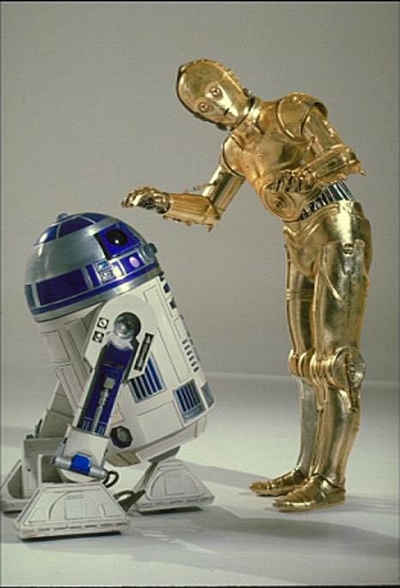
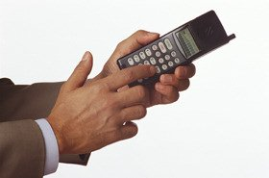
The Dream
It’d be great if machines could
Process our email (usefully)
Translate languages accurately
Help us manage, summarize, and aggregate information
Use speech as a UI (when needed)
Talk to us / listen to us
But they can’t:
Language is complex, ambiguous, flexible, and subtle
Good solutions need linguistics and machine learning knowledge
So:

Slide 14

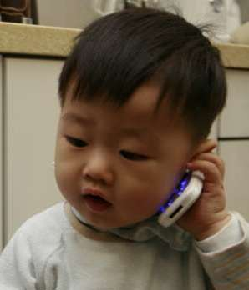
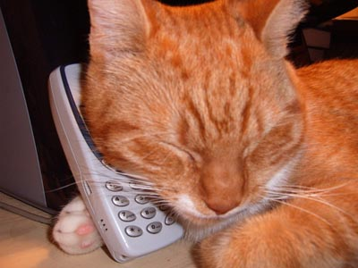
The mystery
What’s now impossible for computers (and any other species) to do is effortless for humans
✕
✕
✓

Slide 15
The mystery (continued)
Patrick Suppes, eminent philosopher, in his 1978 autobiography:
“…the challenge to psychological theory made by linguists to provide an adequate theory of language learning may well be regarded as the most significant intellectual challenge to theoretical psychology in this century.”
So far, this challenge is still unmet in the 21st century
Natural language processing (NLP) is the discipline in which we study the tools that bring us closer to meeting this challenge

Slide 16
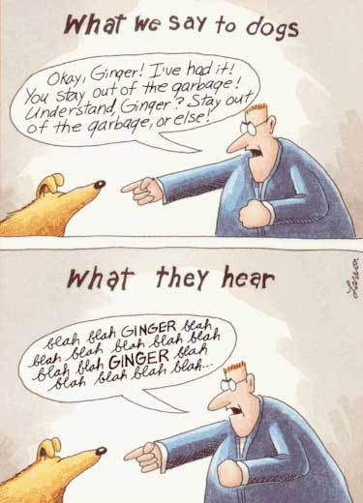
What is NLP?
Fundamental goal: deep understand of broad language
Not just string processing or keyword matching!

Slide 17
What is NLP
Computers use (analyze, understand, generate) natural language
Text Processing
Lexical: tokenization, part of speech, head, lemmas
Parsing and chunking
Semantic tagging: semantic role, word sense
Certain expressions: named entities
Discourse: coreference, discourse segments
Speech Processing
Phonetic transcription
Segmentation (punctuations)
Prosody

Slide 18
Why Should You Care?
Trends
An enormous amount of knowledge is now available in machine readable form as natural language text
Conversational agents are becoming an important form of human-computer communication
Much of human-human communication is now mediated by computers

Slide 19
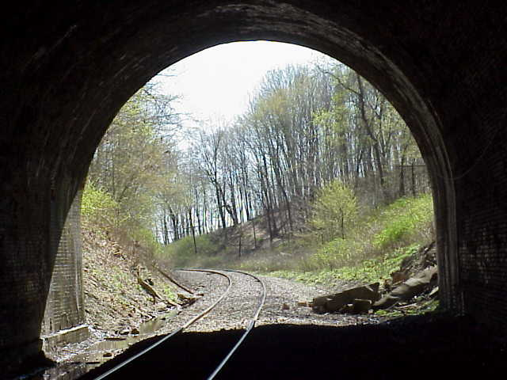
Any Light at The End of The Tunnel?
Yahoo, Google, Microsoft → Information Retrieval
Monster.com, HotJobs.com (Job finders) → Information Extraction + Information Retrieval
Systran powers Babelfish → Machine Translation
Ask Jeeves → Question Answering
Myspace, Facebook, Blogspot → Processing of User-Generated Content
Tools for “business intelligence”
All “Big Guys” have (several) strong NLP research labs:
IBM, Microsoft, AT&T, Xerox, Sun, etc.
Academia: research in an university environment

Slide 20









Commercial World
Lot’s of exciting stuff going on…
Powerset

Slide 21
The Steps in NLP
**we can go up, down and up and
down and combine steps too!!
**every step is equally complex

Slide 22
Major Topics
Words
Syntax
Meaning
Discourse
5. Applications exploiting each

Slide 23
Simple Applications
Word counters (wc in UNIX)
Spell Checkers, grammar checkers
Predictive Text on mobile handsets

Slide 24
Bigger Applications
Intelligent computer systems
NLU interfaces to databases
Computer aided instruction
Information retrieval
Intelligent Web searching
Data mining
Machine translation
Speech recognition
Natural language generation
Question answering

Slide 25
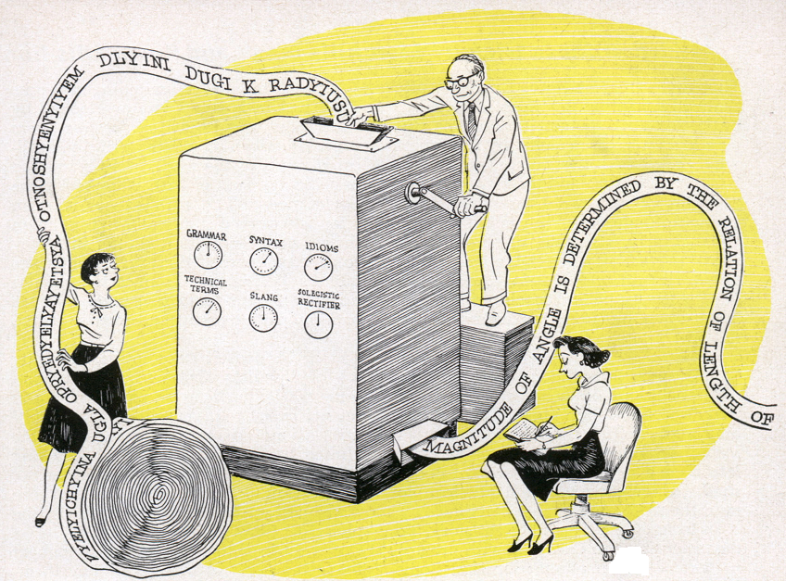
Other Popular NLP tasks: Machine Translation
<stoken id=“S1”>戏</stoken> <ttoken id=“T1” align=“S5 S6”>School</stoken>
<stoken id=“S2”>剧</stoken> <ttoken id=“T2”>of</stoken>
<stoken id=“S3”>舞</stoken> <ttoken id=“T3” align=“S1 S2”>Theatre</stoken>
<stoken id=“S4”>蹈</stoken> <ttoken id=“T4”>and</stoken>
<stoken id=“S5”>学</stoken> <ttoken id=“T5” align=“S3 S4”>Dance</stoken>
<stoken id=“S6”>院</stoken> <ttoken id=“T6” align=“S7 S8”>presents</stoken>
<stoken id=“S7”>演</stoken> <ttoken id=“T7” align=“S9 S10”>Wonderful</stoken>
<stoken id=“S8”>出</stoken> <ttoken id=“T7” align=“S12 S13”>town</stoken>
<stoken id=“S9”>奇</stoken>
<stoken id=“S10”>妙</stoken>
<stoken id=“S11”>的</stoken>
<stoken id=“S12”>小</stoken>
<stoken id=“S13”>镇</stoken>

Slide 26
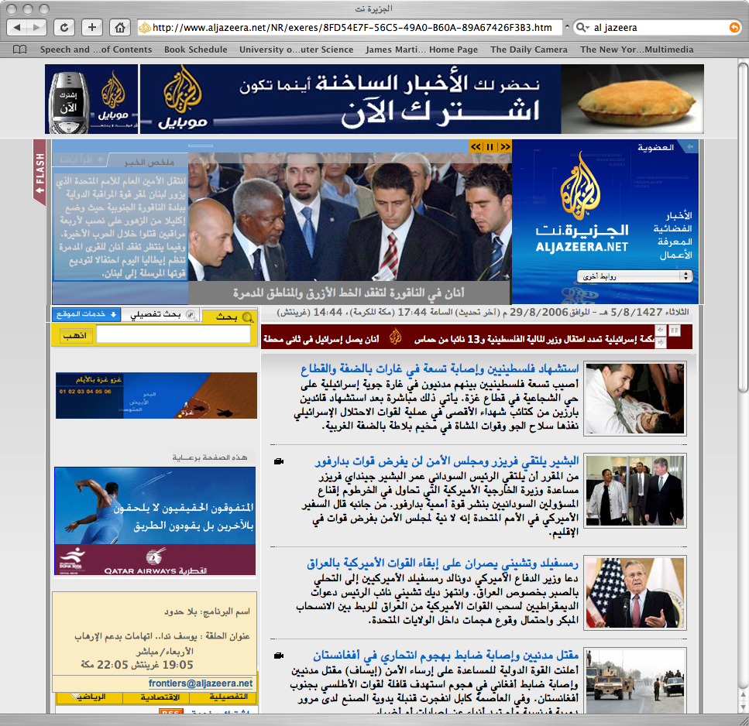
Google Translate

Slide 27
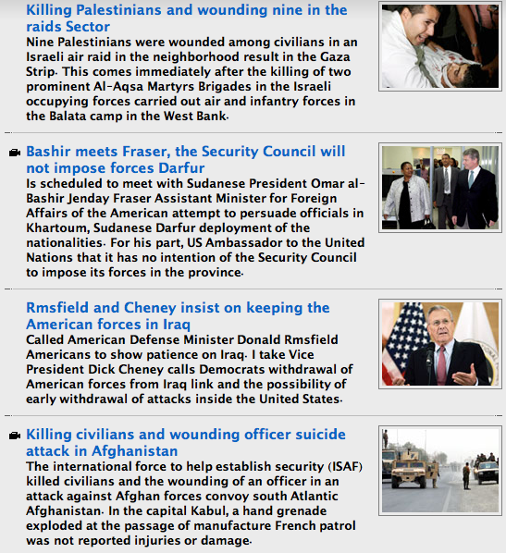
Google Translate

Slide 28
Other Popular NLP tasks: Weblog and Tweet Analytics
Data-mining of Weblogs, discussion forums, message boards, user groups, tweets, and other forms of user generated media
Product marketing information
Political opinion tracking
Social network analysis
Buzz analysis (what’s hot, what topics are people talking about right now).

Slide 29
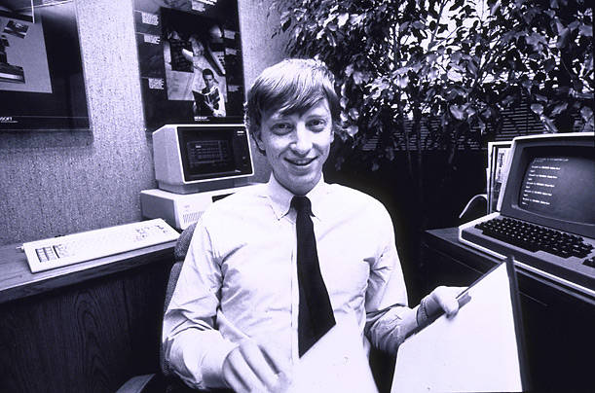



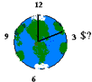

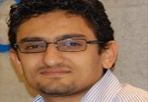

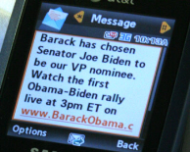

NLP for Big Data
640K ought to be enough for anybody.
Huge Size
Google processes 20 PB a day (2008)
Wayback Machine has 3 PB + 100 TB/month (3/2009)
Facebook has 2.5 PB of user data + 15 TB/day (4/2009)
eBay has 6.5 PB of user data + 50 TB/day (5/2009)
80% data is unstructured (IBM, 2010)
More importantly, Heterogeneous
Time/Location/
Cost Constraints
Texts
Authors
Venues
Notes:
The whole motivation comes from big data. When we talk about big data, we usually mean its big size. E.g. google processes 20 petabyte every day. Previous work cared about how to process this kind of large data efficiently. However, more importantly, 80% of these data is unstructured data. So we need some techniques to extract structured facts from it. Also even more importantly, all of these data come from hetereogenous source. Such as multimedia, differnet genres, languages, and embedded in rich context. Bill gates in 1981 said 640K is probably enough for everyone. This claim is probably still true.
₂₉

Slide 30


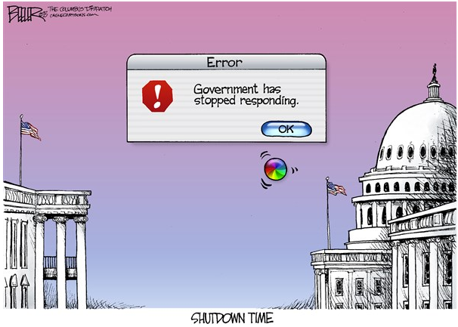



Heterogeneous Big Data
The Patient Protection and Affordable Care Act (PPACA),[1] commonly called the Affordable Care Act (ACA) or Obamacare, is a United States federal statute signed into law by President Barack Obama on March 23, 2010.
NSF and NIST are temporarily closed because the Government entered a period of partial shutdown.
The U.S. Congress, still in partisan deadlock over Republican efforts to halt President Barack Obama's healthcare reforms, was on the verge of shutting down most of the U.S. government starting on Tuesday morning.
President Obama's 70-minute White House meeting late Wednesday afternoon with congressional leaders including House Speaker John Boehner, did nothing to help end the impasse.
Lockheed Martin to furlough 3,000 workers amid \#USGovernmentShutdown
Notes:
We can also explore social media by checking whether the users posted the morph and the target candidate have close social correlation. The social distance can be computed from explicit social networks, but it can be also inferred by checking the content similarity of the message the users posted. By checking the temporal and social corelations, we can reduce the number of candidates into 1%, but keep the correct targets in the pool.

Slide 31
From Big Data to Information: Go Beyond Google
CAUSAL
SUB-EVENT
COREFERENCE
US congress
(agent)
NSF
(organization)
Lockheed
Martin
(Employer)
Obama
(attendee)
Barack Obama
(approver)
[Title: President
Employer: US]
MEET
CLOSE-ORG
LEAVE
CLOSE-ORG
SIGN
COREFERENCE
Healthcare
reform
(cause)
NIST
(organization)
US
government
(organization)
John Boehner
(attendee)
[Title: House Speaker
Member of: Republican
Residence: Ohio]
3000
Workers
(Employee)
Obamacare
(act)
2010/03/03
Doc1
2013/10/01
Doc2
2013/10/02
Doc3
2013/10/02
Doc4
2013/10/03
Doc5

Slide 32
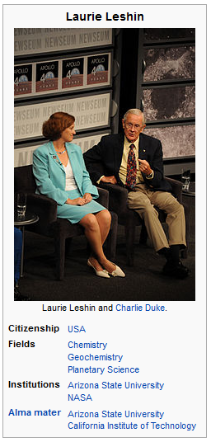
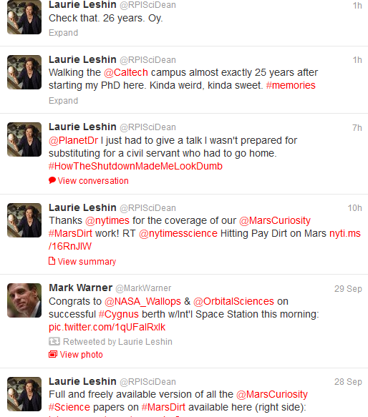
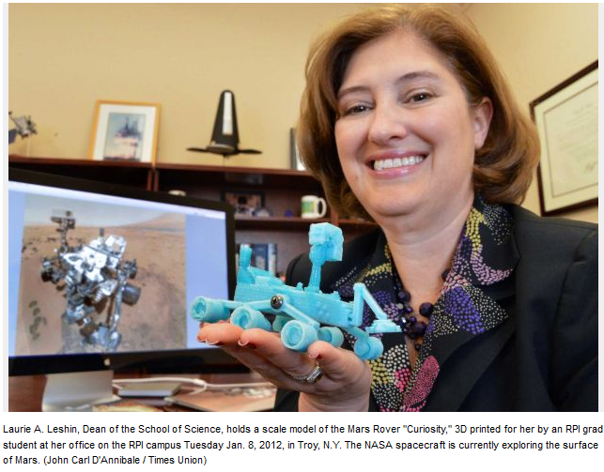
From Information to Knowledge
School Attended: Caltech
Projects: MarsCuriosity

Slide 33
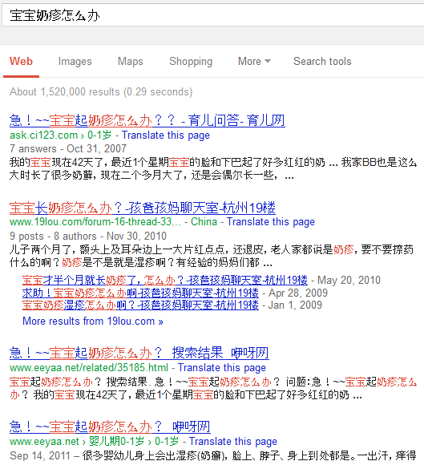
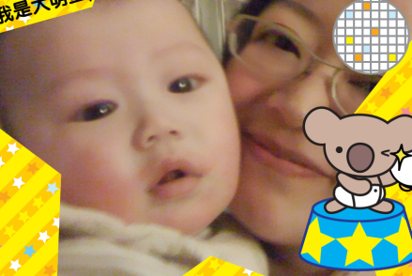
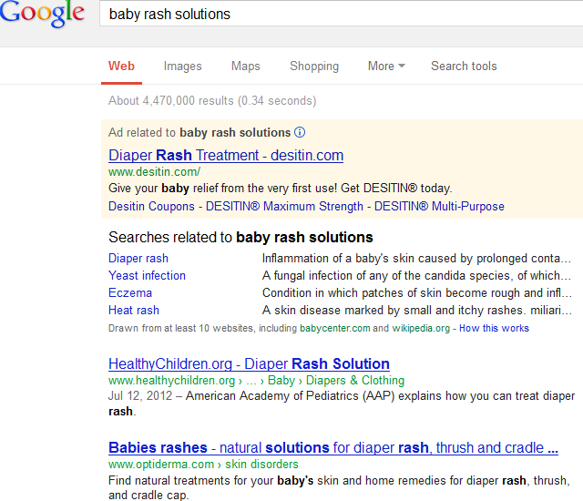
Example: Depressed working mom seeking help…
Notes:
Let me start my talk with my own personal story. When I got a baby over last summer, he had very bad baby rash. So I was desperately looking for some effective treatment. However, I tried playing with many keywords, and different language at google, but I failed. E.g. english side. They are talking about diaper rash. Chinese side, returned the same question pages. Both returned too many pages to read.

Slide 34
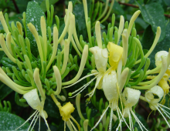

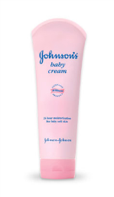
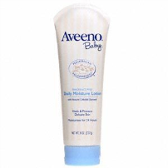

What she hopes to get is something like…
Source | Solution | Effectiveness | Efficacy | Price | Closest store
Chinese |  | 85%, 400 | 2 months | $2 | Hongkong supermarket, NYC
 |  | 95%, 500 | 1 day | $10 | Beijing Children’s Hospital
Western |  | 50%, 100 | 1 week | $20 | Duane Reade, NJ
 |  | 55%, 150 | 1 week | $25 | CVS, NJ
 |  | 60%, 200 | 3 days | $30 | CVS, NJ
√
Notes:
What I really wanted is sth like this; a very informative knowledge base, which can tell me the top choices; people’s comments; aggregated conclusion, and where I can buy it.

Slide 35
Outline
Course Overview
Introduction to NLP
Introduction to Watson
Watson in NLP View
Machine Learning for NLP
Why NLP is Hard

Slide 36
What is Watson?
A computer system that can compete in real-time at the human champion level on the American TV quiz show Jeopardy.
http://www.youtube.com/watch?v=WFR3lOm_xhE
IBM computer designed to compete on the game show Jeopardy!
Culmination of 4 years of dedicated research, and over a decade of advancements in algorithms pertaining to natural language parsing (NLP)

Slide 37
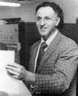
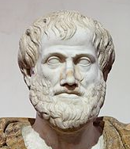
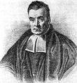
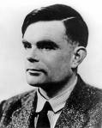
How Does Watson Fit in?
Systems that think like humans “The exciting new effort to make computers think… machines with minds, in the full and literal sense.” (Haugeland, 1985) “[The automation of] activities that we associate with human thinking, activities such as decision-making, problem solving, learning…” (Bellman, 1978) | Systems that think rationally “The study of mental faculties through the use of computational models.” (Charniak and McDermott, 1985) “The study of the computations that make it possible to perceive, reason, and act.” (Winston, 1972)
Systems that act like humans “The art of creating machines that perform functions that require intelligence when performed by people” (Kurzweil, 1990) “The study of how to make computers do things at which, at the moment, people are better (Rich and Knight, 1991) | Systems that act rationally “The branch of computer science that is concerned with the automation of intelligent behavior.” (Luger and Stubblefield, 1993) “Computational intelligence is the study of the design of intelligent agents.” (Poole et al., 1998) “AI… is concerned with intelligent behavior in artifacts.” (Nilsson, 1998)
Richard Bellman (1920-84)
Aristotle (384BC -322BC)
Thomas Bayes (1702-1761)
Alan Turing (1912-1954)
Notes:
Adapted from: Stuart J. Russell and Peter Norvig. _Artificial Intelligence: A Modern Approach_, 2nd ed. Prentice Hall, 2003.

Slide 38
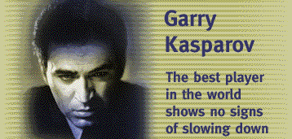
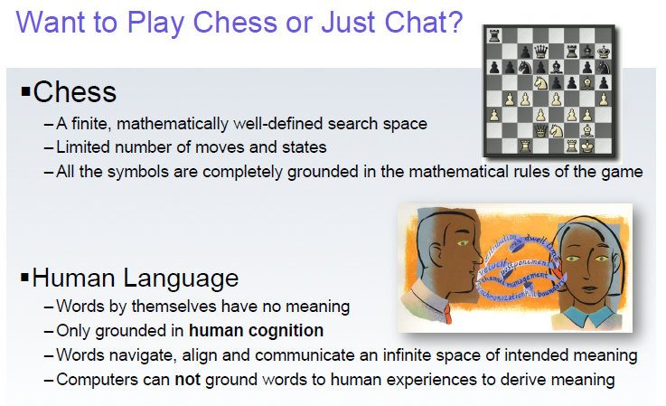
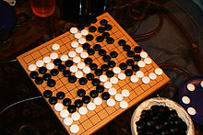
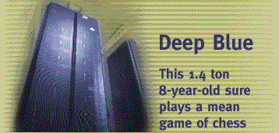
Chess and Go
Notes:
http://www.research.ibm.com/deepblue/meet/html/d.3.shtml,
http://en.wikipedia.org/wiki/Go_%28game%29,
both accessed 2011-02-15

Slide 39
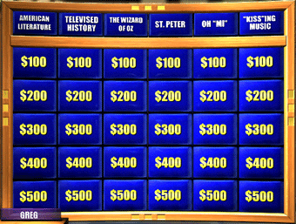
Jeopardy Requires a Broad Knowledge Base
http://j-archive.com/
Factual knowledge
History, science, politics
Commonsense knowledge
E.g., naïve physics and gender
Vagueness, obfuscation, uncertainty
E.g., “KISS”ing music

Slide 40
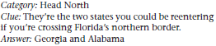
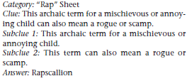
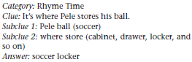
The Questions: Solution Methods
Factoid questions
Decomposition
Puzzles

Slide 41
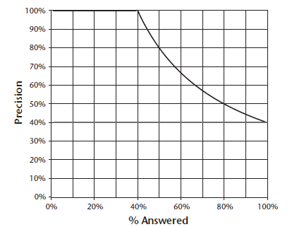
Precision vs. Percentage Attempted
Upper line: perfect confidence estimation
Notes:
There is a thick horizontal line at 40% corresponding to no confidence estimation.

Slide 42
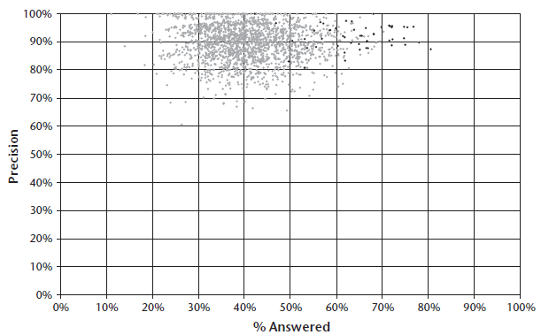
Champion Human Performance
Dark dots correspond to Ken Jenning’s games

Slide 43
Overarching Principles
Massive parallelism
Many experts
Facilitate the integration, application, and contextual evaluation of a wide range of loosely coupled probabilistic question and content analytics.
Pervasive confidence estimation
Integrate shallow and deep knowledge

Slide 44
Outline
Course Overview
Introduction to NLP
Introduction to Watson
Watson in NLP View
Machine Learning for NLP
Why NLP is Hard

Slide 45
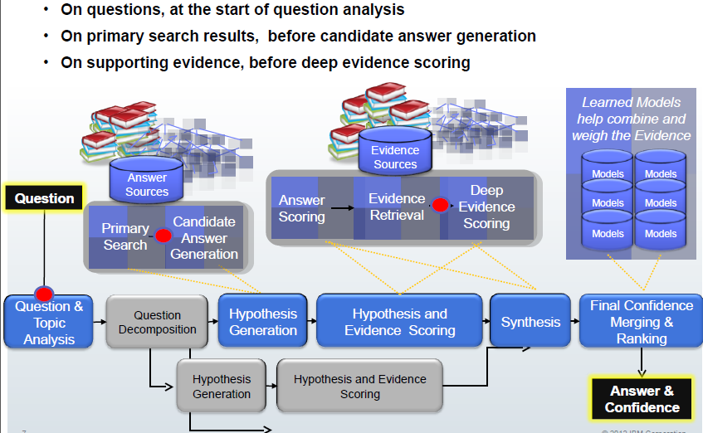
An NLP view of Watson

Slide 46
Key NLP Components
Baseline Search
Math basics, Information Retrieval
Question Understanding
Lexical Analysis, Part-of-Speech Tagging, Parsing
Deep Document Understanding
Syntactic Parsing
Semantic Role Labeling
Dependency Parsing
Name Tagging
Coreference Resolution
Relation Extraction
Temporal Information Extraction
Event Extraction
Answer Ranking, Confidence Estimation
Knowledge Base Construction, Population and Utilization

Slide 47
What We have as Input
Question: when and where did Billy Mays die?
Source Collection: millions of news, web blogs, discussion forums, tweets, Wikipedia, …
Question Parsing:
[Billy Mays, date-of-death]
[Billy Mays, place-of-death]

Slide 48
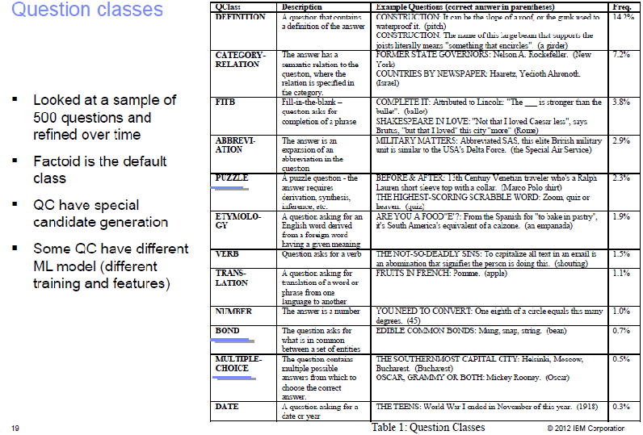
Question Analysis

Slide 49
Part-of-Speech Tagging and Syntactic Parsing
S
NP
VP
NN
IN
NP
VBZ
NP
School
of
NP
CC
NP
presents
JJ
NN
NN
and
NN
Wonderful
Town
Theatre
Dance

Slide 50
Semantic Role Labeling: Adding Semantics into Trees
S
NP/ARG0
VP
DT
JJ
NN
VBD
NP/ARG2
NP/ARG1
The
Supreme
Court
gave
NNS
VBG
NN
states
working
Leeway/ARG0
Predicate
Predicate

Slide 51
Core Arguments
Arg0 = agent
Arg1 = direct object / theme / patient
Arg2 = indirect object / benefactive / instrument / attribute / end state
Arg3 = start point / benefactive / instrument / attribute
Arg4 = end point

Slide 52
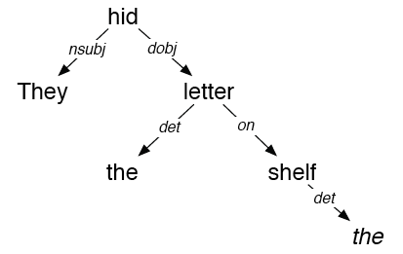
Dependency Parsing
They hid the letter on the shelf

Slide 53
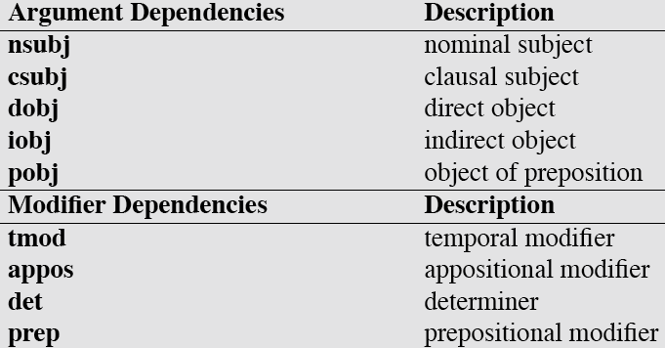
Dependency Relations

Slide 54
Name Tagging
Since its inception in 2001, <name ID=“1” type=“organization”>Red</name>has caused a stir in
<name ID=“2” type=“location”>Northeast Ohio</name> by stretching the boundaries of classical by adding multi-media elements to performances and looking beyond the expected canon of composers.
Under the baton of <name ID=“3” type=“organization”> Red</name> Artistic Director <name ID=“4” type=“person”>Jonathan Sheffer</name>, <name ID=“5” type=“organization”>Red</name> makes its debut appearance at <name ID=“6” type=“organization”> Kent State University</name> on March 7 at 7:30 p.m.

Slide 55
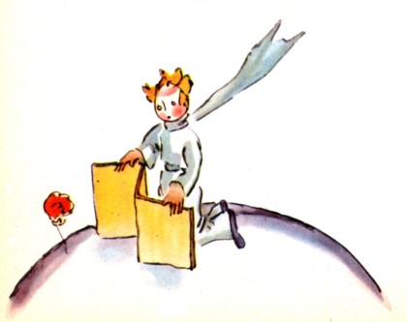
Coreference
But the little prince could not restrain admiration:
"Oh! How beautiful you are!"
"Am I not?" the flower responded, sweetly. "And I was born at the same moment as the sun . . ."
The little prince could guess easily enough that she was not any too modest--but how moving--and exciting--she was!
"I think it is time for breakfast," she added an instant later. "If you would have the kindness to think of my needs--"
And the little prince, completely abashed, went to look for a sprinkling-can of fresh water. So, he tended the flower.

Slide 56
Relation Extraction
relation: a semantic relationship between two entities
ACE relation type example
Agent-Artifact Rubin Military Design, the makers of the Kursk
Discourse each of whom
Employment/ Membership Mr. Smith, a senior programmer at Microsoft
Place-Affiliation Salzburg Red Cross officials
Person-Social relatives of the dead
Physical a town some 50 miles south of Salzburg
Other-Affiliation Republican senators

Slide 57
Temporal Information Extraction
In 1975, after being fired from Columbia amid allegations that he used company funds to pay for his son's bar mitzvah, Davis founded Arista
Is ‘1975’ related to the employee_of relation between Davis and Arista?
If so, does it indicate START, END, HOLDS… ?
Each classification instance represents a temporal expression in the context of the entity and slot value.
We consider the following classes
START Rob joined Microsoft in 1999.
END Rob left Microsoft in 1999.
HOLDS In 1999 Rob was still working for Microsoft.
RANGE Rob has worked for Microsoft for the last ten years.
NONE Last Sunday Rob’s friend joined Microsoft.
57

Slide 58
Event Extraction
An event is specific occurrence that implies a change of states
event trigger: the main word which most clearly expresses an event occurrence
event arguments: the mentions that are involved in an event (participants)
event mention: a phrase or sentence within which an event is described, including trigger and arguments
ACE defined 8 types of events, with 33 subtypes
ACE event type/subtype Event Mention Example
Life/Die Kurt Schork died in Sierra Leone yesterday
Transaction/Transfer GM sold the company in Nov 1998 to LLC
Movement/Transport Homeless people have been moved to schools
Business/Start-Org Schweitzer founded a hospital in 1913
Conflict/Attack the attack on Gaza killed 13
Contact/Meet Arafat’s cabinet met for 4 hours
Personnel/Start-Position She later recruited the nursing student
Justice/Arrest Faison was wrongly arrested on suspicion of murder
Argument, role=victim
trigger

Slide 59
Putting Together: Candidate Answer Extraction
Mays, 50, had died in his sleep at his Tampa home the morning of June 28.
{NUM }
【Per:age】
{PER.Individual, NAM, Billy Mays}
【Query】
50
Mays
amod
nsubj
{Death-Trigger}
aux
died
Tampa
prep_in
located_in
had
sleep
prep_at
nn
home
poss
{FAC.Building-Grounds.NOM}
prep_of
poss
his
June,28
{PER.Individual.PRO, Mays}

Slide 60


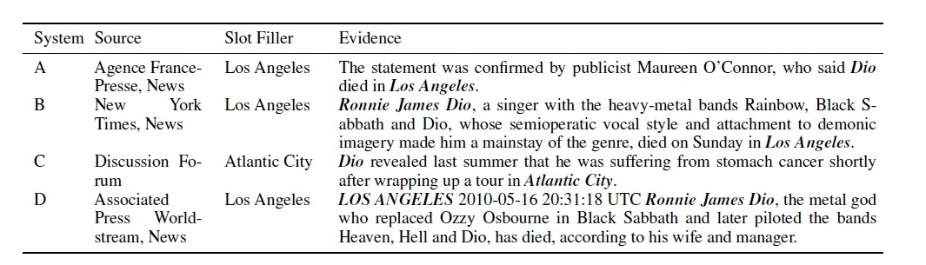
Ranking Answers/Confidence Estimation
Problems:
different information sources may generate claims with varied trustability
various systems may generate erroneous, conflicting, redundant, complementary, ambiguously worded, or inter-dependent claims from the same set of documents

Slide 61
Ranking Answers
Hard Constraints
Used to capture the deep syntactic and semantic knowledge that is likely to pertain to the propositional content of claims.
Node Constraints
e.g., Entity type, subtype and mention type
Path Constraints
Trigger phrases, relations and events, path length
Position of a particular node/edge type in the path
Interdependent Claims
Conflicting slot fillers
Inter-dependent slot types
Notes:
For each slot filler node, we construct its local knowledge graph by including context nodes which are reachable by traversing at most two dependency edges.

Slide 62
Ranking Answers
Soft Features:
Cleanness
Informativeness
Local Knowledge Graph
Voting
Notes:
For each slot filler node, we construct its local knowledge graph by including context nodes which are reachable by traversing at most two dependency edges.

Slide 63
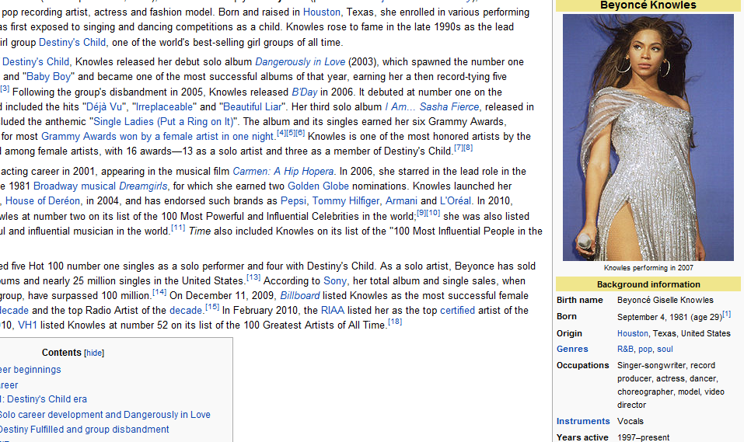
NLP+Knowledge Base
Knowledge Base (KB)
Attributes (a.k.a., “slots”) derived from Wikipedia infoboxes are used to create the reference KB
Source Collection
A large corpus of unstructured texts

Slide 64
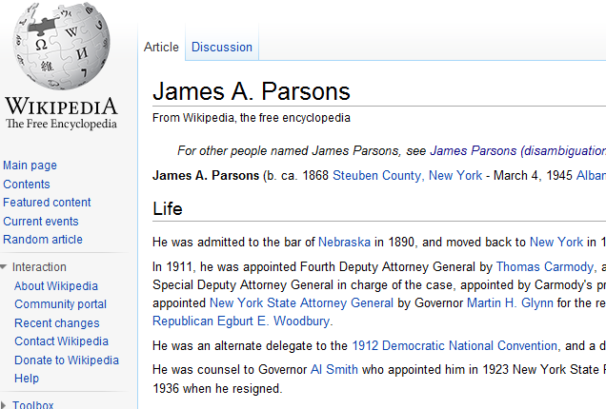
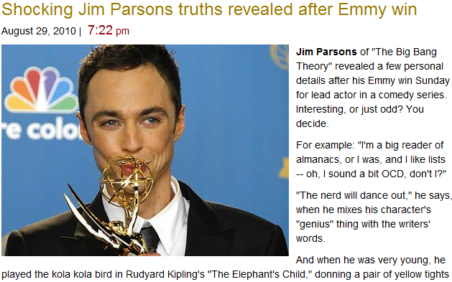

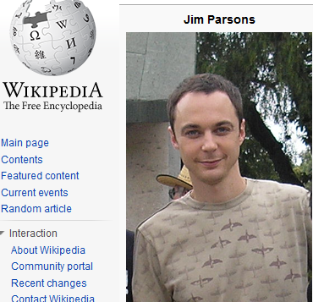
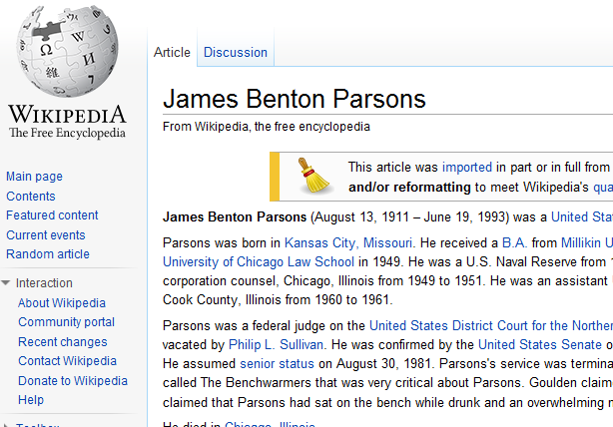
Knowledge Base Linking (Wikification)
NIL
Query = “James Parsons”

Slide 65
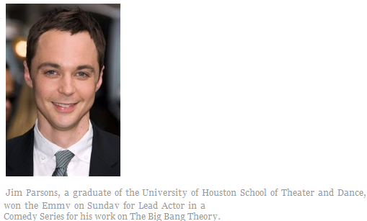
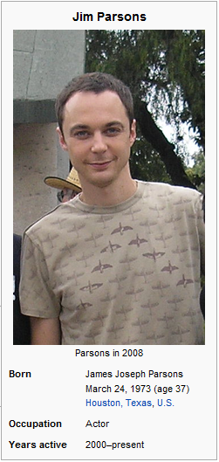
Knowledge Base Population (Slot Filling)
<query id="SF114">
<name>Jim Parsons</name>
<docid>eng-WL-11-174592-12943233</docid>
<enttype>PER</enttype>
<nodeid>E0300113</nodeid>
<ignore>per:date_of_birth
per:age per:country_of_birth
per:city_of_birth</ignore>
</query>
School Attended: University of Houston

Slide 66
KB Slots
Person |  | Organization
per:alternate_names | per:title | org:alternate_names
per:date_of_birth | per:member_of | org:political/religious_affiliation
per:age | per:employee_of | org:top_members/employees
per:country_of_birth | per:religion | org:number_of_employees/members
per:stateorprovince_of_birth | per:spouse | org:members
per:city_of_birth | per:children | org:member_of
per:origin | per:parents | org:subsidiaries
per:date_of_death | per:siblings | org:parents
per:country_of_death | per:other_family | org:founded_by
per:stateorprovince_of_death | per:charges | org:founded
per:city_of_death |  | org:dissolved
per:cause_of_death |  | org:country_of_headquarters
per:countries_of_residence |  | org:stateorprovince_of_headquarters
per:stateorprovinces_of_residence |  | org:city_of_headquarters
per:cities_of_residence |  | org:shareholders
per:schools_attended |  | org:website

Slide 67
Text to Speech Synthesis
ATT:
http://www.research.att.com/~ttsweb/tts/demo.php
IBM
http://www-306.ibm.com/software/pervasive/tech/demos/tts.shtml
Cepstral
http://www.cepstral.com/cgi-bin/demos/general
Rhetorical (= Scansoft)
http://www.rhetorical.com/cgi-bin/demo.cgi
Festival
http://www-2.cs.cmu.edu/~awb/festival_demos/index.html

Slide 68
Information Retrieval
①
②
③
① Relevant Document Set
② Sentence Set[Tree representation]
③ Extracted Paths

Slide 69

Question Answering

Slide 70
Outline
Course Overview
Introduction to NLP
Introduction to Watson
Watson in NLP View
Machine Learning for NLP
Why NLP is Hard

Slide 71
Models and Algorithms
By models we mean the formalisms that are used to capture the various kinds of linguistic knowledge we need.
Algorithms are then used to manipulate the knowledge representations needed to tackle the task at hand.

Slide 72
Some Early NLP History
1950s:
Foundational work: automata, information theory, etc.
First speech systems
Machine translation (MT) hugely funded by military (imagine that)
Toy models: MT using basically word-substitution
Optimism!
1960s and 1970s: NLP Winter
Bar-Hillel (FAHQT) and ALPAC reports kills MT
Work shifts to deeper models, syntax
… but toy domains / grammars (SHRDLU, LUNAR)
1980s/1990s: The Empirical Revolution
Expectations get reset
Corpus-based methods become central
Deep analysis often traded for robust and simple approximations
Evaluate everything

Slide 73

Two Generations of NLP
Hand-crafted Systems – Knowledge Engineering [1950s– ]
Rules written by hand; adjusted by error analysis
Require experts who understand both the systems
and domain
Iterative guess-test-tweak-repeat cycle
Automatic, Trainable (Machine Learning) System [1985s– ]
The tasks are modeled in a statistical way
More robust techniques based on rich annotations
Perform better than rules (Parsing 90% vs. 75% accuracy)

Slide 74

Corpora
A corpus is a collection of text
Often annotated in some way
Sometimes just lots of text
Balanced vs. uniform corpora
Examples
Newswire collections: 500M+ words
Brown corpus: 1M words of tagged “balanced” text
Penn Treebank: 1M words of parsed WSJ
Canadian Hansards: 10M+ words of aligned French / English sentences
The Web: billions of words of who knows what

Slide 75
Resources: Existing Corpora
Brown corpus, LOB Corpus, British National Corpus
Bank of English
Wall Street Journal, Penn Tree Bank, Nombank, Propbank, BNC, ANC, ICE, WBE, Reuters Corpus
Canadian Hansard: parallel corpus English-French
York-Helsinki Parsed corpus of Old Poetry
Tiger corpus – German
CORII/CODIS - contemporary written Italian
MULTEX 1984 and The Republic in many languages
MapTask

Slide 76
Paradigms
In particular..
State-space search
To manage the problem of making choices during processing when we lack the information needed to make the right choice
Dynamic programming
To avoid having to redo work during the course of a state-space search
CKY, Earley, Minimum Edit Distance, Viterbi, Baum-Welch
Classifiers
Machine learning based classifiers that are trained to make decisions based on features extracted from the local context

Slide 77
Information Units of Interest - Examples
Explicit units:
Documents
Lexical units: words, terms (surface/base form)
Implicit (hidden) units:
Word senses, name types
Document categories
Lexical syntactic units: part of speech tags
Syntactic relationships between words – parsing
Semantic relationships

Slide 78
Data and Representations
Frequencies of units
Co-occurrence frequencies
Between all relevant types of units (term-doc, term-term, term-category, sense-term, etc.)
Different representations and modeling
Sequences
Feature sets/vectors (sparse)

Slide 79
Learning Methods for NLP
Supervised: identify hidden units (concepts) of explicit units
Syntactic analysis, word sense disambiguation, name classification, relations, categorization, …
Trained from labeled data
Unsupervised: identify relationships and properties of explicit units (terms, docs)
Association, topicality, similarity, clustering
Without labeled data
Semi-supervised: Combinations

Slide 80
Avoiding/Reducing Manual Labeling
Basic supervised setting – examples are annotated manually by labels (sense, text category, part of speech)
Settings in which labeled data can be obtained without manual annotation:
Anaphora, target word selection The system displays the file on the monitor and prints it.
Unsupervised/Semi-supervised Learning approaches →Sometimes referred as unsupervised learning, though it actually addresses a supervised task of identifying an externally imposed class (“unsupervised” training)

Slide 81
Outline
Course Overview
Introduction to NLP
Introduction to Watson
Watson in NLP View
Machine Learning for NLP
Why NLP is Hard

Slide 82
Why NLP is Difficult: Ambiguity
Favorite Headlines
Teacher Strikes Idle Kids
Stolen Painting Found by Tree
Kids Make Nutritious Snacks
Local HS Dropouts Cut in Half
Red Tape Holds Up New Bridges
Man Struck by Lightning Faces Battery Charge
Hospitals Are Sued by 7 Foot Doctors

Slide 83



How can a machine understand these differences?
Get the cat with the gloves.

Slide 84
Ambiguity
Computational linguists are obsessed with ambiguity
Ambiguity is a fundamental problem of computational linguistics
Resolving ambiguity is a crucial goal

Slide 85
Need Cross-source Linking to Reduce Uncertainty
Medical Domain: 33% of abbreviations are ambiguous (Liu et al., 2001), major source of errors in medical NLP (Friedman et al., 2001)
Military Domain
“GA ADT 1, USDA, USAID, Turkish PRT, and the DAIL staff met to create the Wardak Agricultural Steering Committee. “
“DST” = “District Stability Team” or “District Sanitation Technician”?
RA | “rheumatoid arthritis”, “tenal artery”, “right atrium”, “right atrial”, “refractory anemia”, “radioactive”, “right arm”, “rheumatic arthritis”, …
PN | “Penicillin”; “Pneumonia”; “Polyarteritis”; “Nodosa”; “Peripheral neuropathy”; “Peripheral nerve”; “Polyneuropathy”; “Pyelonephritis”; “Polyneuritis”; “Parenteral nutrition”; “Positional Nystagmus”; “Periarteritis nodosa”, …

Slide 86


Uncertainty: Ambiguity Example
Imam Muhammad Ibn
Saud Islamic University
Saudi Arabia
JFK Airport
Attend-school
Nationality
Employee-of
Nationality
Abdul Aziz Al-Omari
Alomari
Al-Umari
Abdulrahman al-Omari
Abdul Rahman Alomari
Alomari
Al-Umari
City-of-residence
Attend-school
Member-of
Supervisor
City-of-residence
Al-Qaeda
Mohamed Atta
Vero Beach,
Florida
Florida
Flight School
Notes:
86
86
Similarly, ambiguiy exists in other domains. E.g. after 911 attacks happened. A person called abdul rahman alomari was mistakenly identified as one of the attackers. He had to jump out say, I’m still alive, and I have no idea about how to fly an airplane. The reason is he was living in the same town as the real attacker, and his name is similar. They were both originally from the same country. Although he was not a jet pilot, he worked at jfk airport.so we will need to incorporate more clear evidence from wider context such as the other entities related to these candidates in order to disambiguate them.

Slide 87

Even More Uncertainty: “Morphing” in Vision
Notes:
From vision

Slide 88



Steganography, Codes, Ciphers and Jargons
Steganography (concealed writing)
Wooden tablets covered with wax
Tattoon it on the scalp of a messenger
Codes
85772 24799 10090 59980 12487
Ciphers
YBTXOB QEB FABP LC JXOZE
Jargons
The nightingale sings at dawn.
Box Seven
Seeks
Tiger5
At
Red Coral
BEWARE
THE
IDES
OF
MARCH
The supply drop
will take place
0100 hours tomorrow
Notes:
From vision

Slide 89


Morphing in Texts
Ramzi bin al-Shibh
To German girlfriend:
“The first semester commences in three weeks.
Two high schools and two universities...
This summer will surely be hot ...
19 certificates for private education and four exams.
Regards to the professor.
Goodbye.
boyfriend
on September 11
World Trade Center
Pentagon and Capitol
19 hijackers
four planes
Bin Laden
Abu Abdul Rahman
Notes:
Our goal is then to reduce uncertainty. Let’s take a step back to watch how human learn knowledge. They usually organized study groups, or committees to discuss things. So in order to reach a concensus. Psychology theory said if a text is more cohernet, it will be easier to understand. Put in the same way, if we make sure the facts we extracted are coherent with each other, they it’s more likely to be corrrect. In order to gather global facts to enforce cohernece, we can get redundant information from multiple sources, such as multiple documents, langauges, data modalities, and so on.
Danielle S McNamara. 2001. Reading both High-coherence and Low-coherence Texts: Effects of Text Sequence and Prior Knowledge. Canadian Journal of Experimental Psychology. XXX Use cross-source inference instead of simple information fusion

Slide 90




Morphs in Social Media
=
=
“Conquer West King”
(平西王)
“Bo Xilai”
(薄熙来)
“Baby”
(宝宝)
“Wen Jiabao”
(温家宝)
Morph | Target | Motivation
Blind Man (瞎子) | Chen Guangcheng(陈光诚) | Sensitive
First Emperor (元祖) | Mao Zedong (毛泽东) | Vivid
Kimchi Country (泡菜国) | Korea (韩国) | Vivid
Rice Country (米国) | United States (美国) | Pronunciation
Kim Third Fat (金三胖) | Kim Jong-un (金正恩) | Negative
Miracle Brother (奇迹哥) | Wang Yongping (王勇平) | Irony
Notes:
There is even more uncertainty when we are extracting information from the data under active censorship. E.g. we will see frequently some morphed entities such as peace west king, or best actor in chinese tweets. But they are really referring to the politicians. Because people have to invent creative way to communicate sensitive ideas. The reason they used peace west king is because this king and the politican governed the same place hundreds years ago. Of course to avoid censorship is not the only motivation of creating morphs, sometimes people just create them for fun or sarcasm.
Express sarcasm/verbal irony or positive sentiment
The above chat message example is extremely challenging due to the lack of background contexts. Also it’s probably difficult to get a substantial amount of similar real data sets. However, there are other data sets under active censorship which may be used for a pilot study. For example, Chinese twitter and discussion forum users need to create new ways to communicate sensitive subjects because of the existence of internet information censorship. We call this phenomenon information morph. For example, when Chinese online users talk about the former politician ``Bo Xilai", they use a morph ``Conquer West King" instead, a historical figure four hundreds years ago who governed the same region as Bo. Morph can be considered as a special case of alias used for hiding true entities in malicious environment. Usually morphs are generated by harvesting the collective wisdom of the crowd to achieve certain communication goals. Aside from the purpose of avoiding censorship, other motivations for using morph include expressing sarcasm/irony, positive/negative sentiment or making descriptions more vivid toward some entities or events. We propose the following new implicit RA task:

Slide 91



Morphing
苏亚雷斯(Suarez)
苏牙(Su-tooth)
Notes:
This is also a very interesting category. Morph could be created either from a story or entity’s public reputation and perception. Suarez is a forward in Uruguay. By using weapon of mass destruction, his teeth, he bite the soccer player of Itatly on World Cup yesterday, and finally ensured his team to the next round.

Slide 92
Outline
Course Overview
Introduction to NLP
Introduction to Watson
Watson in NLP View
Machine Learning for NLP
Why NLP is Hard
Some Demos

Slide 93

Demo 1: Knowledge Networks Construction
(Huang et al., 2012)
Notes:
Facilitate a military analyst in expert finding and terrorist information search gathering, control and analysis for any given query
Entity-topic analyzer for self-expansion and self-boosting: Terrorism organization → members → status of members (die, arrest,...) and information networks associated with each member
Motivation:
In many scenarios, a user may only know information about limited portions of objects or dimensions of links and thus have difficulty at creating informative queries
For example, a military data analyst may have a list of famous terrorism organizations without knowing their detailed person member names, but still wish to track activities about these members
Search and Browsing Text-Rich Information Networks
A user can choose any types of certain queries
Developed methods to efficiently trace membership relations, activities and information clusters involving any specific entities
Improve the quality of information by the interconnected network itself (self-boosting information networks)

Slide 94

Demo 2: Temporal Event Tracking
(Chen and Ji, 2009)
94
94
Notes:
94

Slide 95

Demo 3: News Gathering from Tweets
http://tt.zubiaga.org/ui/enhanced-2.0/?date=2012/02/25
(Zubiaga, Ji and Knight, 2013)
Notes:
95

Slide 96
Homework
Reading Materials
By Friday 9/5, Send Heng and Qi an email:
Your email address to be added to mailing list (if you are not in yet)
Your September time constraints for a make-up class
Your brief background
Which year in which program
NLP, machine learning, math, linguistics etc. related courses that you have taken
Research topics
Comments/suggestions
Notes:
For each slot filler node, we construct its local knowledge graph by including context nodes which are reachable by traversing at most two dependency edges.

